Slide 1
Evolution of the Major Programming Languages
Chapter 2
CS 304 – Programming Languages – Ch. 2

Slide 2
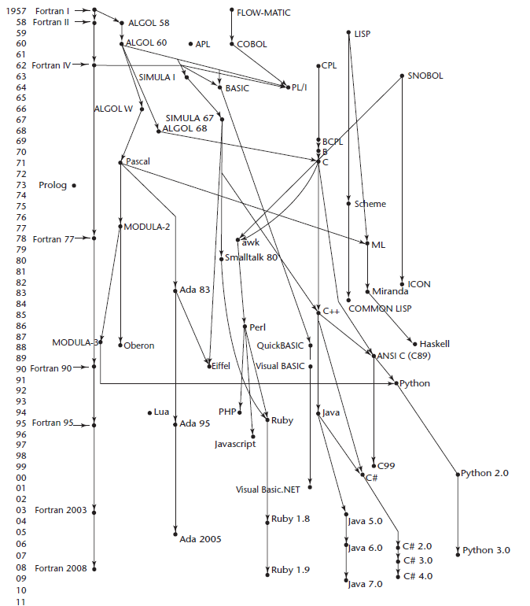
History of Programming Languages (PLs)
CS 304 – Programming Languages – Ch. 2

Slide 3
Zuse’s Plankalkul
1936-1945 : Conrad Zuse
Plankalkul : Proposal for a PhD dissertation
  Published in 1972!!!
  Never implemented
  Advanced data structures
    floating point, arrays, records
  Invariants
Notation:
  A(7) := 5 * B(6)
  | 5 * B => A
  V | 6 7 (subscripts)
  S | 1.n 1.n (data types)
CS 304 – Programming Languages – Ch. 2

Slide 4
Pseudocodes
What was wrong with using machine code?
  a. Poor readability
  b. Poor modifiability
    Absolute Addressing – “noop” instruction
  c. Expression coding was tedious
  d. Machine deficiencies--no indexing or floating point
Short code; 1949; BINAC; Mauchly
  Expressions were coded, left to right
Some operations:
  1n => (n+2)nd power
  2n => (n+2)nd root
  07 => addition
CS 304 – Programming Languages – Ch. 2

Slide 5
Pseudocodes
Speedcoding; 1954; IBM 701, Backus
  Pseudo ops for arithmetic and math functions
  Conditional and unconditional branching
  Autoincrement registers for array access
  Slow!
  Only 700 words left for user program
Laning and Zierler System - 1953
  Implemented on the MIT Whirlwind computer
  First "algebraic" compiler system
  Subscripted variables, function calls, expression translation
  Never ported to any other machine
CS 304 – Programming Languages – Ch. 2

Slide 6
FORTRAN
FORTRAN I - 1957
  (FORTRAN 0 - 1954 - not implemented)
  Designed for the new IBM 704, which had index registers and floating point hardware
  Environment of development:
1. Computers were huge and unreliable
2. Applications were scientific
3. No programming methodology or tools
4. Machine efficiency was most important
  Impact of environment on design:
1. No need for dynamic storage
2. Need good array handling and counting loops
3. No string handling, decimal arithmetic, or powerful input/output (commercial stuff)
CS 304 – Programming Languages – Ch. 2

Slide 7
FORTRAN
First implemented version of FORTRAN
- Names could have up to six characters
- Posttest counting loop (DO)
- Formatted i/o
- User-defined subprograms
- Three-way selection statement (arithmetic IF)
- No data typing statements
- No separate compilation
- Compiler released in April 1957, after 18 worker/
years of effort
- Programs larger than 400 lines rarely compiled correctly, mainly due to poor reliability of the 704
- Code was very fast
- Quickly became widely used
CS 304 – Programming Languages – Ch. 2

Slide 8
FORTRAN
FORTRAN II - 1958
  Independent compilation
  Fix the bugs
FORTRAN IV - 1960-62
  Explicit type declarations
  Logical selection statement
  Subprogram names could be parameters
  ANSI standard in 1966
FORTRAN 77 - 1978
  Character string handling
  Logical loop control statement
  IF-THEN-ELSE statement
CS 304 – Programming Languages – Ch. 2

Slide 9
FORTRAN
FORTRAN 90 - 1990
  Modules
  Dynamic arrays
  Pointers
  Recursion
  CASE statement
  Parameter type checking
FORTRAN Evaluation
  Dramatically changed forever the way computers are used
CS 304 – Programming Languages – Ch. 2

Slide 10
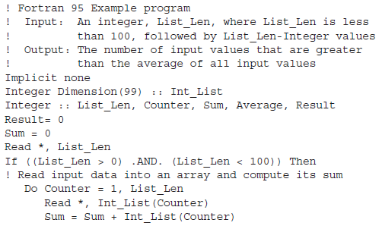
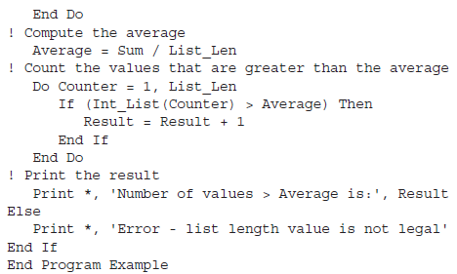
Example FORTAN Program
CS 304 – Programming Languages – Ch. 2

Slide 11
LISP
LISP - 1959
  LISt Processing language
    Lots of Irritating Stupid Parentheses ☺
    Designed at MIT by McCarthy
  AI research needed a language that:
    1. Process data in lists (rather than arrays)
    2. Symbolic computation (rather than numeric)
  Only two data types: atoms and lists
  Syntax is based on lambda calculus
  Pioneered functional programming
  No need for variables or assignment
  Control via recursion and conditional expressions
  Still the dominant language for AI
    COMMON LISP and Scheme are contemporary dialects of LISP
    ML, Miranda, and Haskell are related languages
CS 304 – Programming Languages – Ch. 2

Slide 12
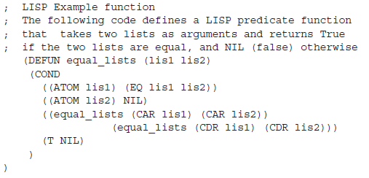
Example LISP Program
CS 304 – Programming Languages – Ch. 2

Slide 13
ALGOL
ALGOL 58 - 1958
  Environment of development:
  1. FORTRAN had (barely) arrived for IBM 70x
  2. Many other languages were being developed, all for specific machines
  3. No portable language; all were machine-dependent
  4. No universal language for communicating algorithms
  ACM and GAMM met for four days for design
  Goals of the language:
  1. Close to mathematical notation
  2. Good for describing algorithms
  3. Must be translatable to machine code
CS 304 – Programming Languages – Ch. 2

Slide 14
ALGOL
Language Features:
  Concept of type was formalized
  Names could have any length
  Arrays could have any number of subscripts
  Parameters were separated by mode (in & out)
  Subscripts were placed in brackets
  Compound statements (begin ... end)
  Semicolon as a statement separator
  Assignment operator was :=
  if had an else-if clause
Comments:
  Not meant to be implemented, but variations of it were (MAD, JOVIAL)
  Although IBM was initially enthusiastic, all support was dropped by mid-1959
CS 304 – Programming Languages – Ch. 2

Slide 15
ALGOL
ALGOL 60 - 1960
  Modified ALGOL 58 at 6-day meeting in Paris
  New Features:
    Block structure (local scope)
    Two parameter passing methods
    Subprogram recursion
    Stack-dynamic arrays
Still no i/o and no string handling
Successes:
  It was the standard way to publish algorithms for over 20 years
  All subsequent imperative languages are based on it
  First machine-independent language
  First language whose syntax was formally defined (BNF)
Failure:
  Never widely used, especially in U.S.
  Reasons:
    1. No i/o and the character set made programs nonportable
    2. Nonportable
    3. Too flexible--hard to implement
    4. Intrenchment of FORTRAN
    5. Formal syntax description
    6. Lack of support of IBM
CS 304 – Programming Languages – Ch. 2

Slide 16
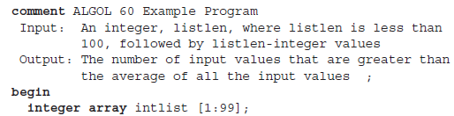
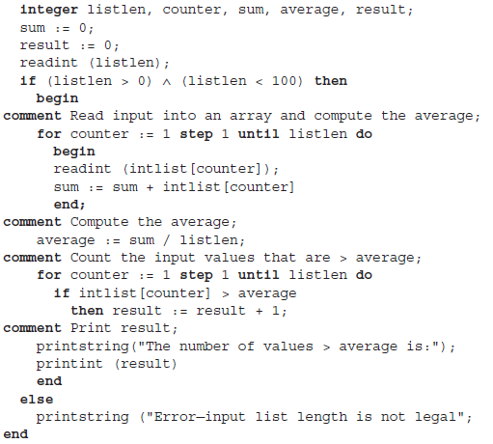
Example ALGOL Program
CS 304 – Programming Languages – Ch. 2

Slide 17
COBOL
COBOL - 1960
Environment of development:
  UNIVAC was beginning to use FLOW-MATIC
  USAF was beginning to use AIMACO
  IBM was developing COMTRAN
Based on FLOW-MATIC
  FLOW-MATIC features:
    Names up to 12 characters, with embedded hyphens
    English names for arithmetic operators
    Data and code were completely separate
    Verbs were first word in every statement
First Design Meeting - May 1959
Design goals:
  1. Must look like simple English
  2. Must be easy to use, even if that means it will be less powerful
  3. Must broaden the base of computer users
  4. Must not be biased by current compiler problems
CS 304 – Programming Languages – Ch. 2

Slide 18
COBOL
Design committee were all from computer manufacturers and DoD branches
Design Problems: arithmetic expressions? subscripts? ➔ Fights !
Contributions:
  First macro facility in a high-level language
  Hierarchical data structures (records)
  Nested selection statements
  Long names (up to 30 characters), with hyphens
  Data Division
Comments:
  First language required by DoD; would have failed without DoD
  Still the most widely used business applications language
CS 304 – Programming Languages – Ch. 2

Slide 19
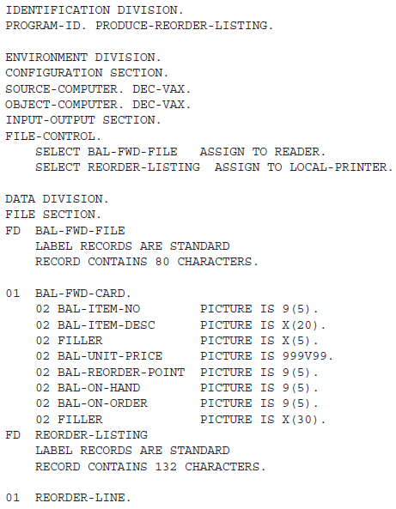
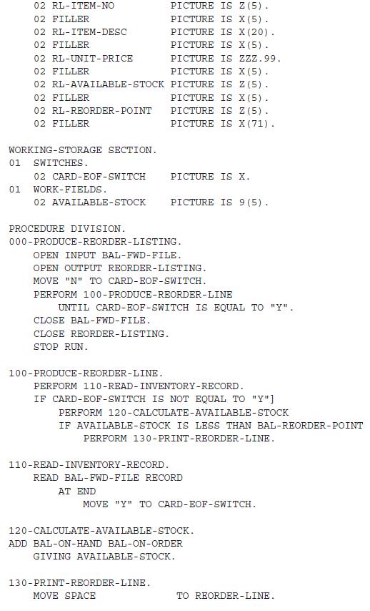
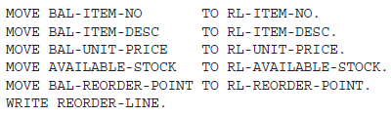
Example COBOL Program
CS 304 – Programming Languages – Ch. 2

Slide 20
BASIC
BASIC - 1964
  Designed by Kemeny & Kurtz at Dartmouth
  Design Goals:
    Easy to learn and use for non-science students
    Must be ”pleasant and friendly"
    Fast turnaround for homework
    Free and private access
    User time is more important than computer time
Current popular dialects: QuickBASIC and Visual BASIC
CS 304 – Programming Languages – Ch. 2

Slide 21
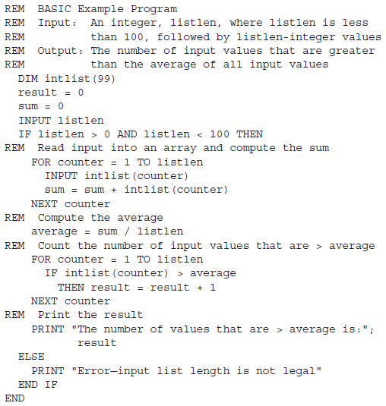
Example BASIC Program
CS 304 – Programming Languages – Ch. 2

Slide 22
PL/I
PL/I - 1965
  Designed by IBM and SHARE
  Computing situation in 1964 (IBM's point of view)
  1. Scientific computing
  - IBM 1620 and 7090 computers
  - FORTRAN
  - SHARE user group
  2. Business computing
  - IBM 1401, 7080 computers
  - COBOL
  - GUIDE user group
By 1963, however,
  Scientific users began to need more elaborate i/o, like COBOL had; Business users began to need fl. pt. and arrays (MIS)
  It looked like many shops would begin to need two kinds of computers, languages, and support staff-- too costly
CS 304 – Programming Languages – Ch. 2

Slide 23
PL/I
The obvious solution:
  1. Build a new computer to do both kinds of applications
  2. Design a new language to do both kinds of applications
PL/I contributions:
1. First unit-level concurrency
2. First exception handling
3. Switch-selectable recursion
4. First pointer data type
5. First array cross sections
Comments:
  Many new features were poorly designed
  Too large and too complex
  Was (and still is) actually used for both scientific and business applications
CS 304 – Programming Languages – Ch. 2

Slide 24
Early Dynamic Languages
  Characterized by dynamic typing and dynamic storage allocation
APL (A Programming Language) 1962
  Designed as a hardware description language (at IBM by Ken Iverson)
  Highly expressive (many operators, for both scalars and arrays of various dimensions)
  Programs are very difficult to read
SNOBOL(1964)
  Designed as a string manipulation language (at Bell Labs by Farber, Griswold, and Polensky)
  Powerful operators for string pattern matching
CS 304 – Programming Languages – Ch. 2

Slide 25
SIMULA
SIMULA 67 - 1967
  Designed primarily for system simulation (in Norway by Nygaard and Dahl)
  Based on ALGOL 60 and SIMULA I
  Primary Contribution:
  Coroutines - a kind of subprogram
    Implemented in a structure called a class
    Classes are the basis for data abstraction
    Classes are structures that include both local data and functionality
CS 304 – Programming Languages – Ch. 2

Slide 26
ALGOL
ALGOL 68 - 1968
  From the continued development of ALGOL 60, but it is not a superset of that language
  Design is based on the concept of orthogonality
  Contributions:
    1. User-defined data structures
    2. Reference types
    3. Dynamic arrays (called flex arrays)
Comments:
  Had even less usage than ALGOL 60
  Had strong influence on subsequent languages, especially Pascal, C, and Ada
CS 304 – Programming Languages – Ch. 2

Slide 27
PASCAL and C
Pascal – 1971
  Designed by Wirth, who quit the ALGOL 68 committee (didn't like the direction of that work)
  Designed for teaching structured programming
  Small, simple, nothing really new
  Still a very widely used language for teaching programming in colleges (but use is shrinking)
C - 1972
  Designed for systems programming (at Bell Labs by Dennis Richie)
  Evolved primarily from B, but also ALGOL 68
  Powerful set of operators, but poor type checking
  Initially spread through UNIX
CS 304 – Programming Languages – Ch. 2

Slide 28
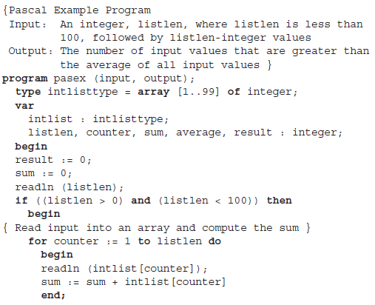
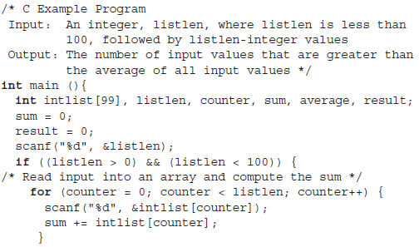
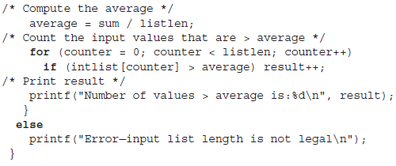
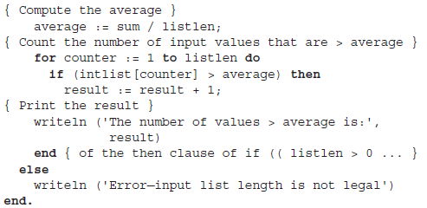
Example Pascal and C Programs
CS 304 – Programming Languages – Ch. 2
Notes:
8/31-end

Slide 29
Other descendants of ALGOL
Modula-2 (mid-1970s by Niklaus Wirth at ETH)
  Pascal plus modules and some low-level features designed for systems programming
Modula-3 (late 1980s at Digital & Olivetti)
  Modula-2 plus classes, exception handling, garbage collection, and concurrency
Oberon (late 1980s by Wirth at ETH)
  Adds support for OOP to Modula-2
  Many Modula-2 features were deleted (e.g., for statement, enumeration types, with statement, noninteger array indices)
Delphi (Borland)
  Pascal plus features to support OOP
  More elegant and safer than C++
CS 304 – Programming Languages – Ch. 2

Slide 30
PROLOG
Prolog - 1972
  Developed at the University of Aix-Marseille, by Comerauer and Roussel, with some help from Kowalski at the University of Edinburgh
  Based on formal logic
  Non-procedural
  Can be summarized as being an intelligent database system that uses an inferencing process to infer the truth of given queries
  Backward chaining
  Planning
CS 304 – Programming Languages – Ch. 2

Slide 31
ADA
Ada - 1983 (began in mid-1970s)
  Huge design effort, involving hundreds of people, much money, and about eight years
  Contributions:
  1. Packages - support for data abstraction
  2. Exception handling - elaborate
  3. Generic program units
  4. Concurrency - through the tasking model
  Comments:
    Competitive design
    Included all that was then known about software engineering and language design
    First compilers were very difficult; the first really usable compiler came nearly five years after the language design was completed
Ada 95 (began in 1988)
  Support for OOP through type derivation
  Better control mechanisms for shared data (new concurrency features)
  More flexible libraries
CS 304 – Programming Languages – Ch. 2

Slide 32
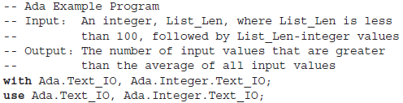
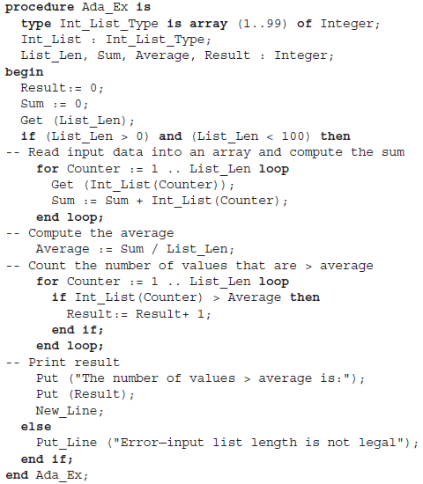
Example ADA Program
CS 304 – Programming Languages – Ch. 2

Slide 33
Smalltalk
Smalltalk - 1972-1980
  Developed at Xerox PARC, initially by Alan Kay, later by Adele Goldberg
  First full implementation of an object-oriented language (data abstraction, inheritance, and dynamic type binding)
  Pioneered the graphical user interface everyone now uses
CS 304 – Programming Languages – Ch. 2

Slide 34
C++
C++ - 1985
  Developed at Bell Labs by B. Stroustrup
  Evolved from C and SIMULA 67
  Facilities for object-oriented programming, taken partially from SIMULA 67, were added to C
  Also has exception handling
  A large and complex language, in part because it supports both procedural and OO programming
  Rapidly grew in popularity, along with OOP
  ANSI standard approved in November, 1997
Eiffel - a related language that supports OOP
  Designed by Bertrand Meyer - 1992
  Not directly derived from any other language
  Smaller and simpler than C++, but still has most of the power
CS 304 – Programming Languages – Ch. 2

Slide 35
JAVA
Java (1995)
  Developed at Sun in the early 1990s by James Goesling
  Based on C++
  Significantly simplified
  Supports only OOP
  Has references, but not pointers
  Includes support for applets and a form of concurrency
  Applets, jsp, web applications
CS 304 – Programming Languages – Ch. 2

Slide 36
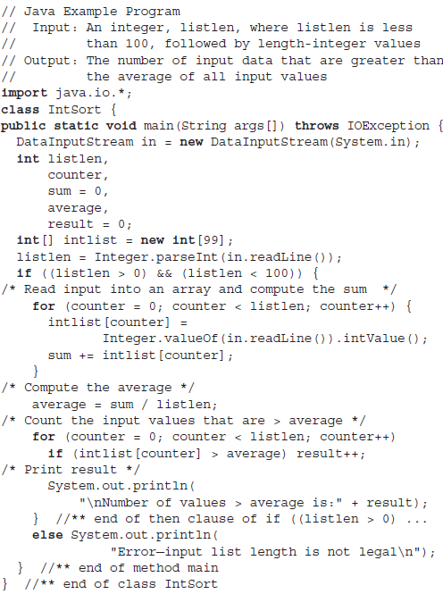
Example Java Program
CS 304 – Programming Languages – Ch. 2

Slide 37
C#
Based on C++ and Java
    Language for the new millennium?
    Perhaps…
  Removed multiple inheritance
  Enum types are safer now
    No conversion to ints
  struct types are better constructed
    Can have constructors and implement interfaces
  Delegates – new types
    OO type-safe method references
  Implicit object-to-primitive type conversions
    And vice-versa
CS 304 – Programming Languages – Ch. 2

Slide 38
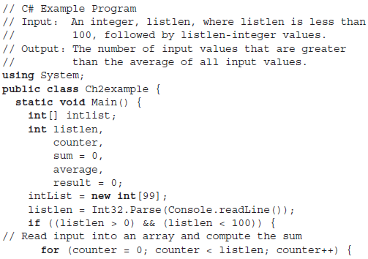
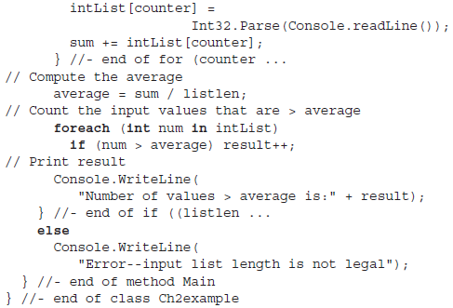
Example C# Program
CS 304 – Programming Languages – Ch. 2

Slide 39
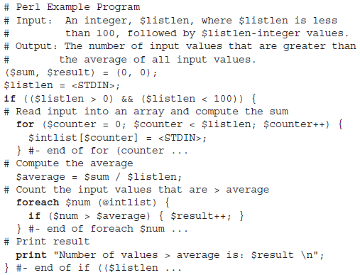

Perl
Combination of
sh and awk
$name – scalar
@name – array
#name – hash
Arrays
  Dynamic length
  and sparse
CS 304 – Programming Languages – Ch. 2

Slide 40
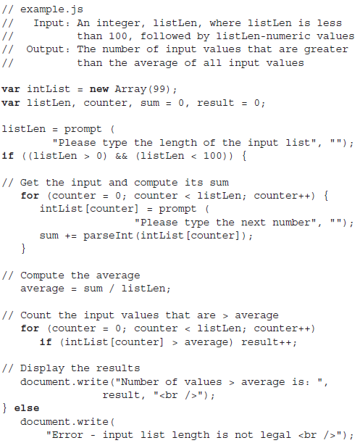
Javascript
Interpreter
  Embedded in Web
  Browsers and HTML
  DOM correspondence
NOT Java!!!
CS 304 – Programming Languages – Ch. 2

